Slide 1
Building a Simple APP based on Python with Web Crawler
Tutor: Wang Di
Instructor: Cuilian Zhao
Reporter: Maosheng Liao

Slide 2
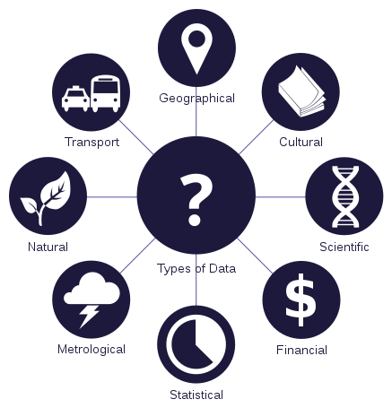
What is surrounding us?
Data
A set of values of qualitative or quantitative variables

Slide 3
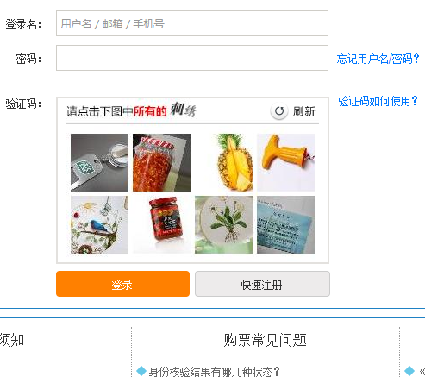
Data Types We Concern
String
Messages sent to WeChat friends, comments on Netease Cloud Music, comments on
Douban Movie, etc
Number
Stock Prices, Futures Marketing sharing, etc
Image
Verification Code , etc
Sound
Music, Voice message in WeChat
Video
Movie, short interesting video on Douying, etc
Others

Slide 4
Categories of Data Analysis
Narrative (e.g. laws, arts)
Descriptive (e.g. social sciences)
Statistical/mathematical (pure/applied sciences)
Others

Slide 5
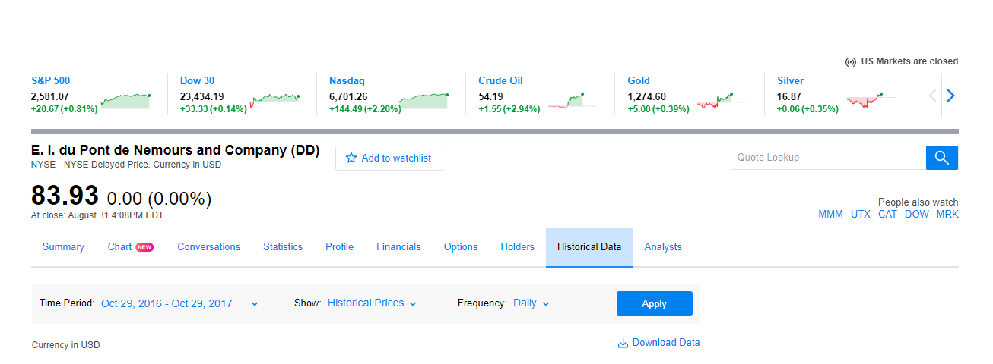
Goal
Visualization of Yahoo Finance top 30 Dowjones stock components and its price fluctuation during the past 1 year.

Slide 6

How to get Data?
Official Sites
Netease has its API of Big Data for individuals or enterprises, etc
Data Reource sites
GroupLens provides several available datasets
Personal ways
Web Crawler
A program or automated script which browses the WorldWide Web in a methodical, automated manner
Spyder on the Web

Slide 7
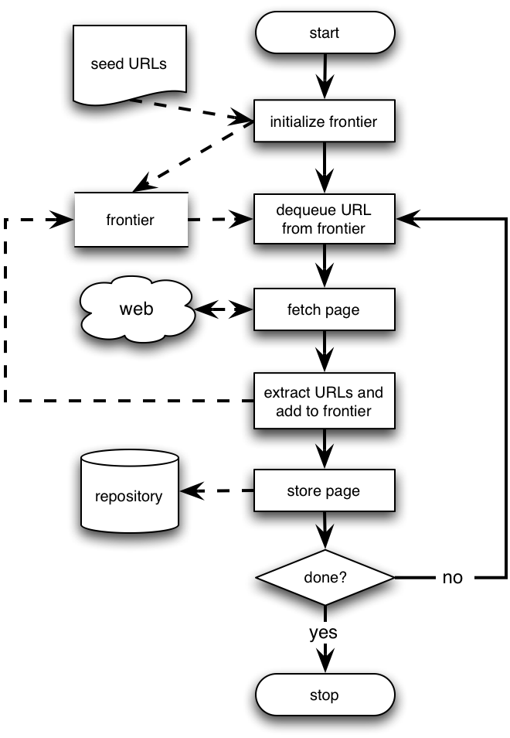
Basic crawlers
This is a sequential crawler
Seeds can be any list of starting URLs
Order of page visits is determined by frontier data structure
Stop criterion can be anything
http://money.cnn.com/data/dow30/
(To get the Symbol)
https://finance.yahoo.com/quote/DD/history?p=DD
(To get the statistics)

Slide 8
Python Implementation
GUI provides interaction with humans
Matplotlib plots image
Data Group to sort data
Web Crawler to get data
Web Crawler
Requests
re
BeautifulSoup
Data Group
Pandas
Numpy
Plot
Matplotlib
GUI
wxPython
Python
Script Programming Language

Slide 9
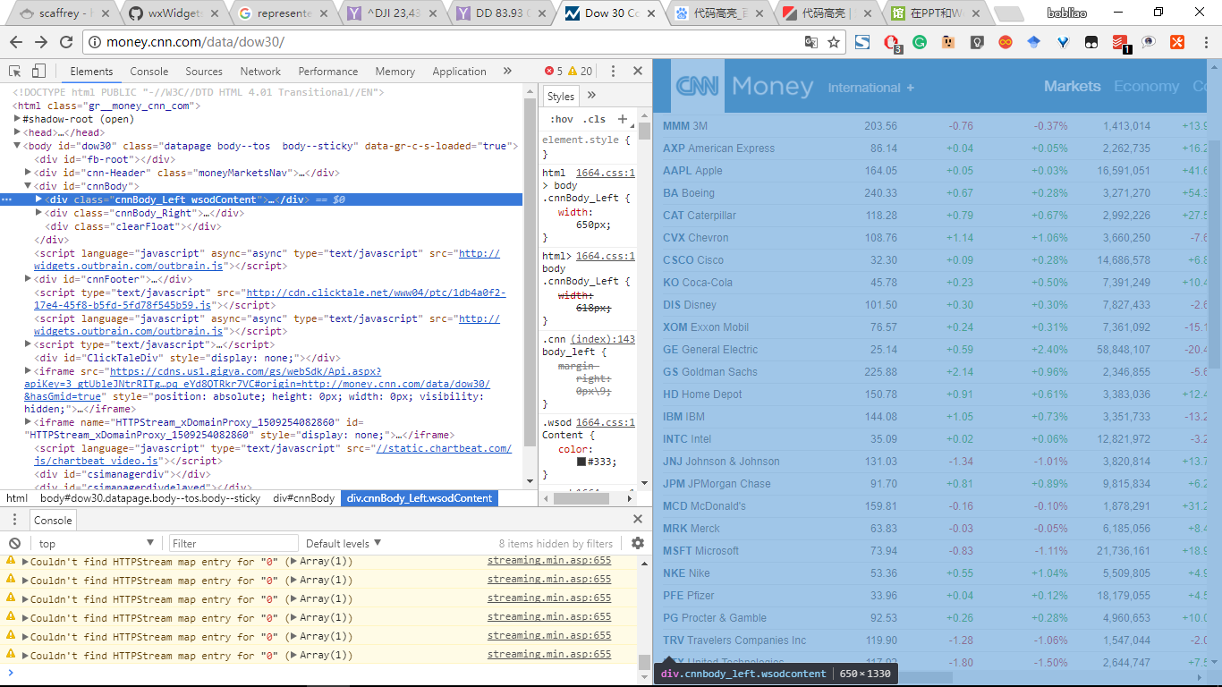
Python Implementation
def get_code_list() :
'''
取得道指成分股代码基本信息
'''
req=requests.get('http://money.cnn.com/data/dow30/')
raw_soup=BeautifulSoup(req.text,'html.parser')
soupList=raw_soup.findAll('tr')
del soupList[0:2]
company_list=[soup.get_text().strip().replace('\xa0','\n').split('\n') for soup in soupList]
return company_list
Source code

Slide 10
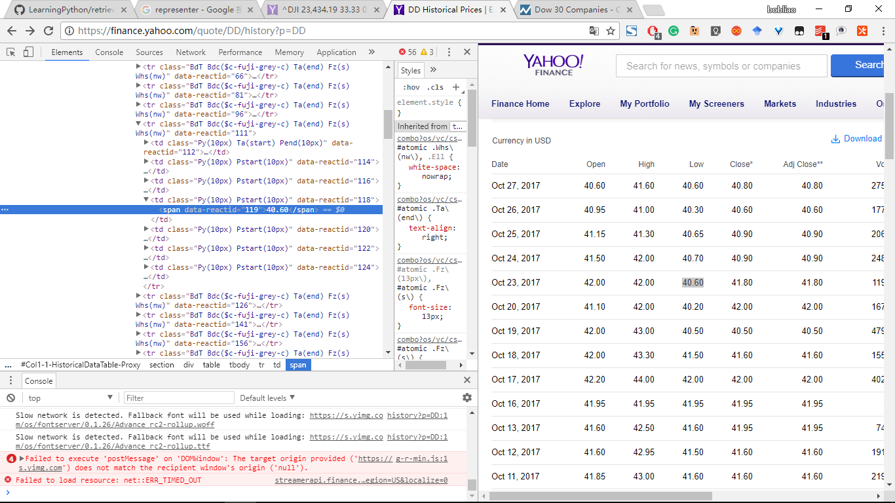
Python Implementation
def retrieve_quotes_historical(stock_code) :
quotes=[]
url='https://finance.yahoo.com/quote/{0}/history?p={1}'.format(stock_code,stock_code)
# req=requests.get(url,verify=True)
req=requests.get(url,verify=True,timeout=10)
if re.match(r'https://finance\.yahoo\.com/quote/(\w+)/history\?p=(\w+)',req.url):
pass
else :
raise RequestException('Url is wrong!')
if req.text :
raw_data=re.findall('"HistoricalPriceStore":{"prices":(.*),"isPending"',req.text)
if raw_data :
quotes=json.loads(raw_data[0])[::-1]
else :
raise RequestException('URL Wrong!')
return [item for item in quotes if not 'type' in item]
Source code

Slide 11
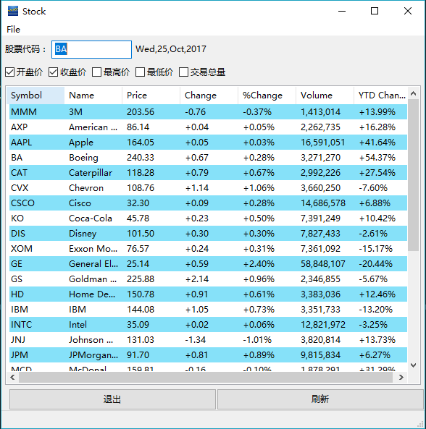
Python Implementation
Let human beings use it!
GUI Design
Source Code

Slide 12
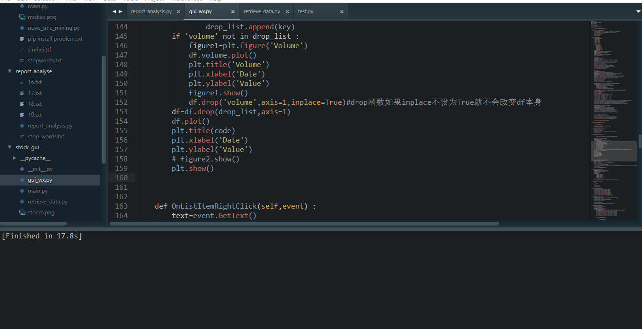
Result

Slide 13
Reference
1.McKinney, Wes. Python for Data Analysis. Beijing: O'Reilly, 2014. Print.
2.Jason Montojo, Jennifer Campbell Paul Gries, Greg Wilson. Practical Programming An Introduction to Computer Science Using Python. 1st ed. Vol. 1. Beijing: Pragmatic helf, 2012. Print.
3.Lawson, Richard G. Web Scraping with Python: Scrape Data from Any Website with the Power of Python. Birmingham: Packt, 2015. Print.
Inspiration source:
The Joy of Data(https://www.bilibili.com/video/av8225730/)

Slide 14
Thank you

Slide 15

>>> r = requests.get('https://api.github.com/user', auth=('user', 'pass')) >>> r.status_code 200 >>> r.headers['content-type'] 'application/json; charset=utf8' >>> r.encoding 'utf-8' >>> r.text u'{"type":"User"...' >>> r.json() {u'private_gists': 419, u'total_private_repos': 77, ...}
Requests
Python HTTP Requests for Humans
Matainer: Kenneth Reitz
>>> r = requests.get('https://api.github.com/user', auth=('user', 'pass'))
>>> r.status_code
200
>>> r.headers['content-type']
'application/json; charset=utf8'
>>> r.encoding
'utf-8'
>>> r.text
u'{"type":"User"...'
>>> r.json()
{u'private_gists': 419, u'total_private_repos': 77, ...}
Back

Slide 16

BeautifulSoup
Beautiful Soup is a Python library for pulling data out of HTML and XML files
A toolkit for dissecting a document and extracting what you need
Automatically converts incoming documents to Unicode and outgoing documents to UTF-8
Support different html/xml parser like lxml and html5lib
Back

Slide 17



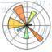

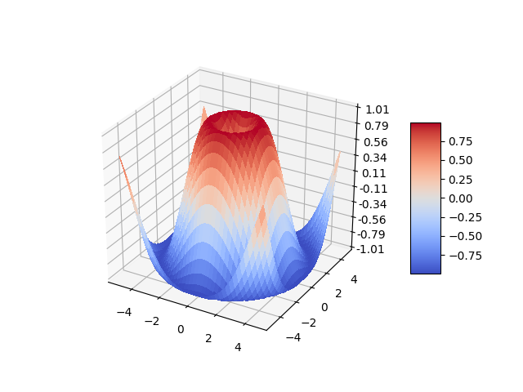
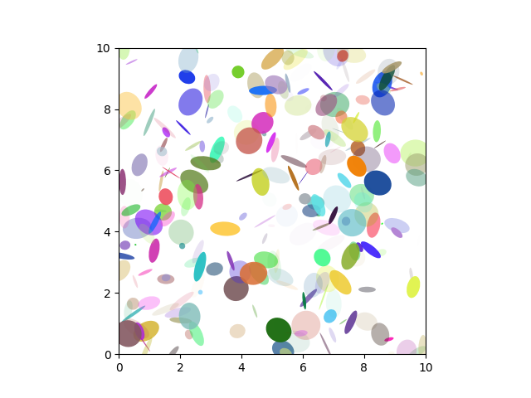
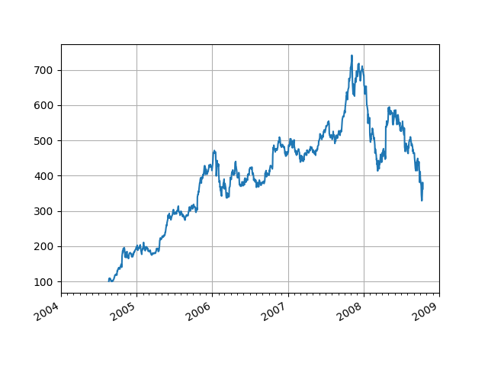
Numpy, Pandas, Matplotlib
Scipy
numpy
matplotlib
pandas
other
SciPy is a Python-based ecosystem of open-source software for mathematics, science, and engineering.
Back

